Slide 1
Project 4
Mariella and Natalia Avanni

Slide 2
Dataset: California Fire Perimeters
This dataset shows information on California wildfires from 1878 (limited data until 1900s) to the beginning of 2025
Current criteria for fires to be included in this dataset: perimeter ≥ 10 acres in timber, ≥50 acres in brush, ≥300 acres in grass, and/or ≥3 damaged/destroyed residential or commercial structures, and/or caused ≥1 fatality
* Note: criteria were modified in 1979, 1991, 1992, 2002, 2006, 2008, 2010
Variables
Audience
Fire name
Agency and unit ID
Alarm and containment date
Cause
GIS calculated acres
Shape area
Shape length
General, educated
No requirement to know about firefighting
Assume knowledge of common graph types
California Fire Perimeters (cnra.gov)

Slide 3
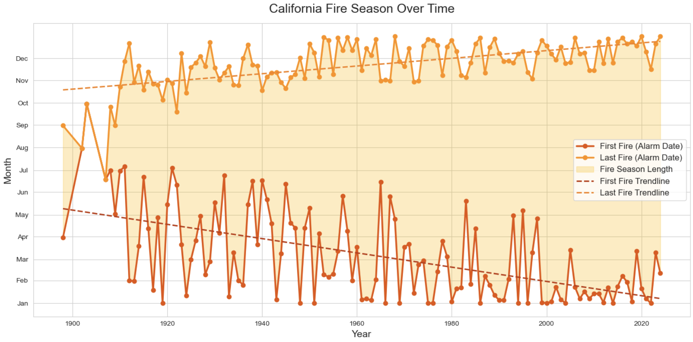
Trust
Data Story: fire season in CA is getting longer and starting sooner
Situational Context: news article where it is expected reader will engage with the graph
Design Features: clear axes labels and legend, similar graph type and style to other reputable sources
Notes:
How has the fire season changed over time?
Are alarm dates starting earlier/later in the year?
Have fire durations changed from 1800s to now?

Slide 4
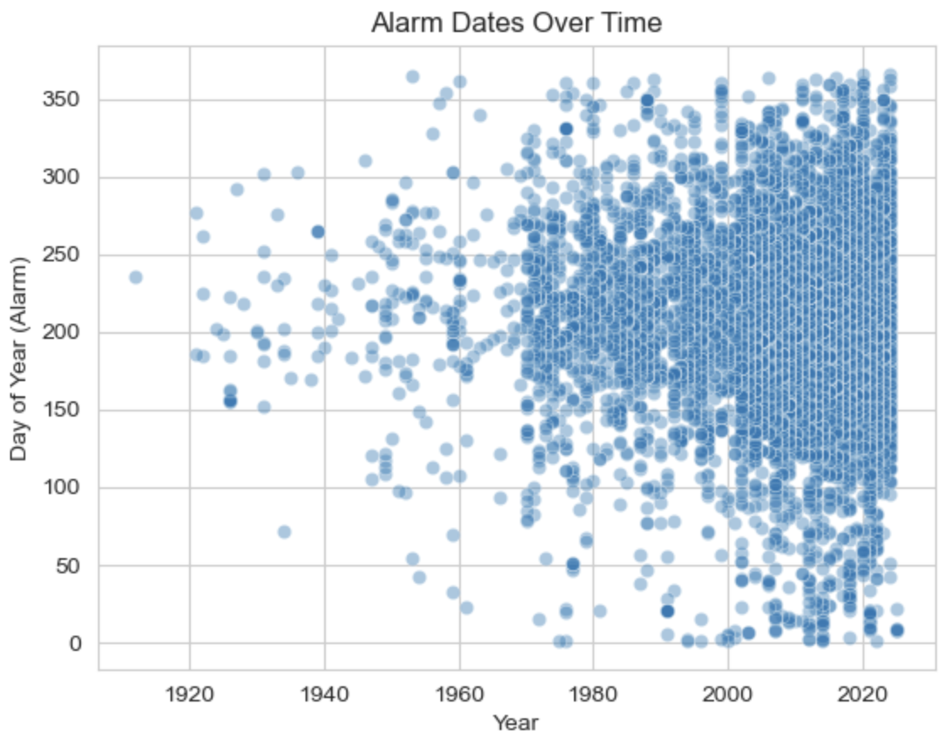
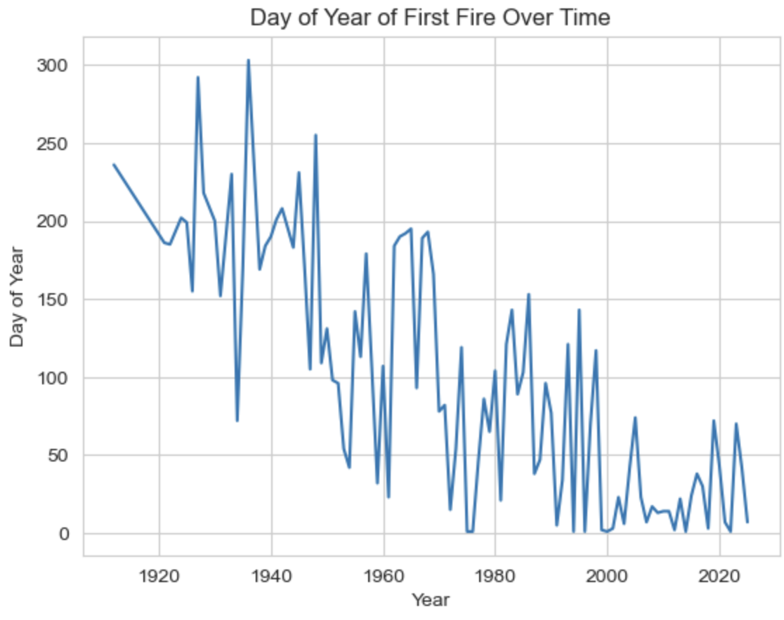
Takeaways
Scatterplot: More fires recently than in 1900s. Concentration of fires more dense around middle of the year, but fire season is expanding past summer.
Line graph: Day of first fire per year has gotten earlier over time. Used to have first first in summer (ie April – October fire season), now extends throughout entire year.

Slide 5
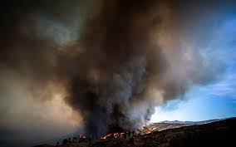
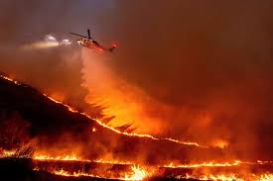
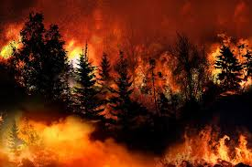
Trickery
Data story: the length of fires (measured from alarm date to containment date) has decreased over time
*actually increased
Situational context: news graphic, maybe in a social media post, intended to be glanced at briefly
Choices to evoke trust: similar aesthetics to other graphs in news coverage about California wildfires (eg timeplot comparing across years), added context in the accompanying caption—transparency on data collection (provenance)

Slide 6
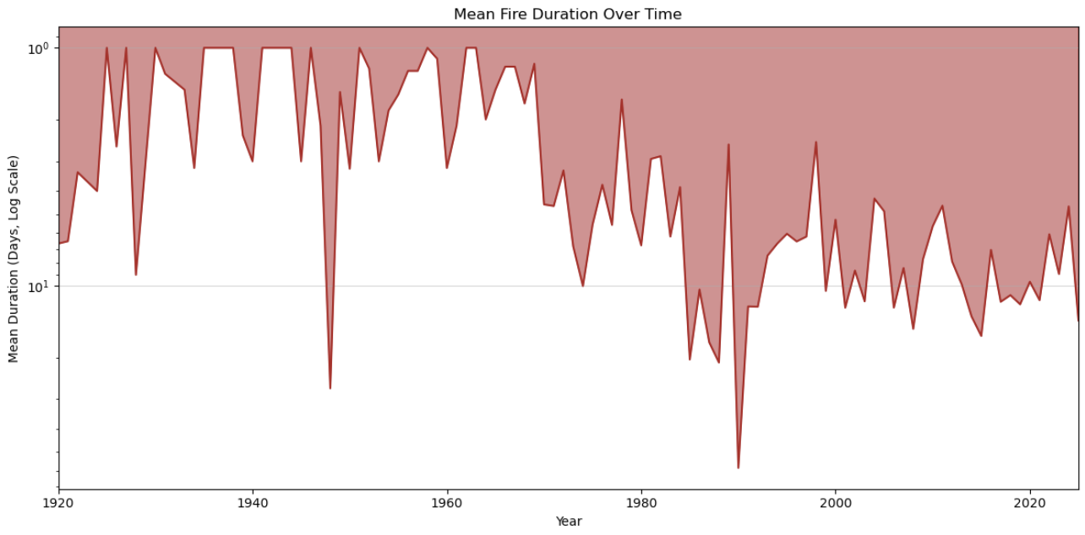
Trickery
Design features to deceive:
Inverted y axis violates convention of axes being upper right of cartesian plane
Assume higher on the plot = larger y-value
Log instead of linear scale exaggerates changes from year to year
Hard to interpret what is driving changes (are typical fires getting longer or are there more mega-events pulling the average?)
Red fill region (area) likely interpreted as additive rather than multiplicative (linear vs log scale), color associated with danger
Average duration of California wildfires, 1920-present (early 2025)
Duration measured from alarm to containment date. Fires whose alarm and containment dates were the same were counted as one day. Values reported from Cal FIRE

Slide 7
Thank you!

